Slide 1
Mini project on electronic voting system

Slide 2
ABSTRACT
In the past people go to polling place and take the blank ballots and punch a hole or append a seal. The rapid advancements in the information and communications technology had given rise to a new application called e-voting or electronic voting. With e-voting we can minimize the human resource, time consumption for counting and rigging.
We implemented the project for the electronic voting system by using C language. Voter Identity card contains all the basic details of the voter including date of birth, gender, locality etc. Each candidate is provided by a unique number on the voter id card. We accept the id of the voter at first. Then followed by basic information of the voter . If data given by voter at time of voting and data given in the card matches, we permit the voter to vote . In the next step we display all the contestant names followed by a unique code to each of them. The voter should press the button as of prescribed unique code of the contestant. After, all the voters had done with voting, counting process starts. The candidate with majority of votes is declared elected.

Slide 3
Software Requirements :
Windows XP
Turbo C
Hardware Requirements :
Hard disk : 10 GB
Processor : Intel
RAM : 1 GB

Slide 4

Voting in INDIA before EVMs

Slide 5
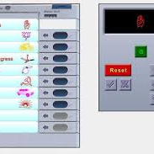
EVMs
A new revolution in system of voting

Slide 6
evoting
Voter
Nomination
Counting
Exit

Slide 7
NOMINATION
Age
Party Name
Name
Nomination
ID

Slide 8
VOTER
Age
Gender
Name
Voter
ID

Slide 9
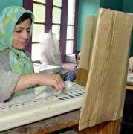
An elaborated process of voting changed to a CLICK

Slide 10
Team Members :
G.JASHWANTH : 1602-12-737-011
N.MANIDEEP REDDY : 1602-12-737-015

Slide 11
THANKS FOR ALLOTING YOUR
VALUABLE TIME FOR US

Slide 12
ANY QUERIES
? ? ? ? ? ?

